Slide 1
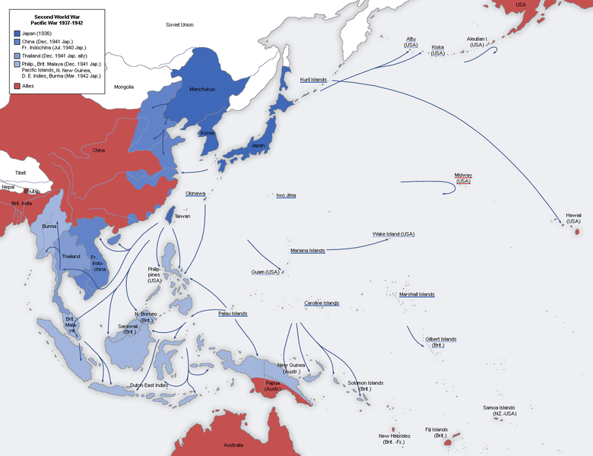
World War II - The Pacific Theatre of War 1942

Slide 2
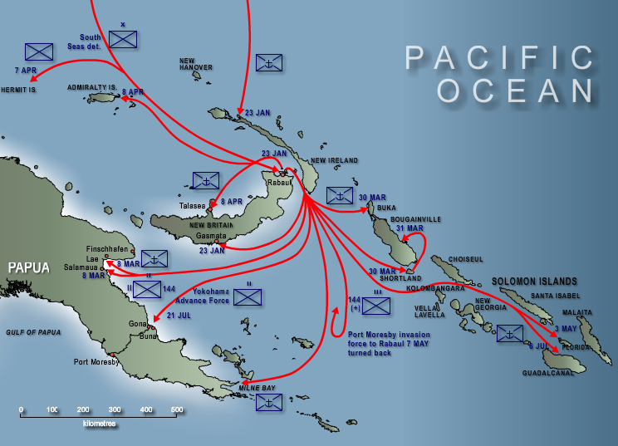
The Japanese Advance Across the Southeastern Pacific and into Papua

